Slide 1

CROP RECOMMENDATION AND WEED DETECTION
Project carried out by
VISHWAJITH V - 412518104169
SURESH KRISHNAA R - 412518104147
ASWIN KUMAR S - 412518104022
Under the guidance of
DR. B. LATHA
PROFESSOR & HEAD/ Department of CSE

Slide 2

Objective
The objective of this project is to develop a system which would be useful to farmers to predict the crops, fertilizer and the yield.
In this project, we propose a system which would suggest crops based on the results obtained using a machine learning approach.
Farmers find comfort in simply following the ancestral farming patterns and norms without realizing the fact that crop output is circumstantial, depending heavily on the present-day weather and soil conditions.

Slide 3
OUTLINE OF PRESENTATION
Objective
Abstract
Literature survey
Proposed System Methodology
Overview of the project with block diagram
Approximate Budget
Work plan (Till the last tentative submission date MARCH 2021)
References

Slide 4
Abstract
Agriculture in India plays a major role in the economy. 70% of Indian population directly relies on agriculture.
The common difficulty present among the Indian farmers is, they don’t opt for the proper crop based on their soil requirements. Due to this, they face a serious setback in productivity. This problem can be solved through precision agriculture.
Weeds are often defined as growth of unwanted plants. Weeds use the same nutrients that crop plants use and weeds may reduce crop yields. This project would solve this problem by distinguishing between crops and weeds using machine learning classification techniques.

Slide 5
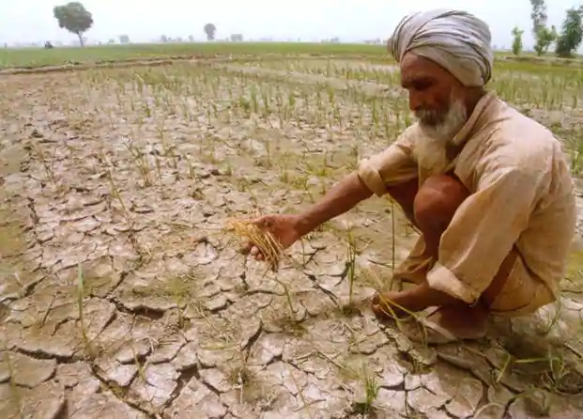
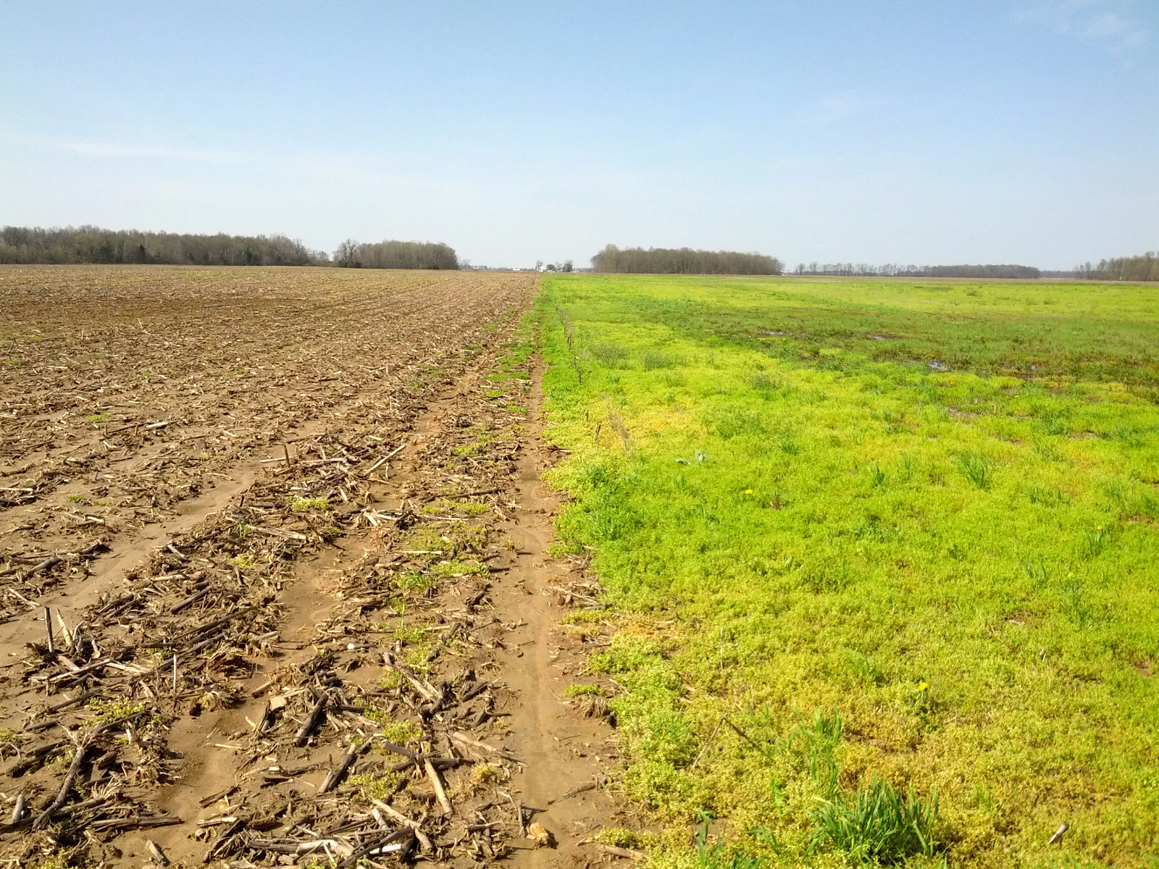
Why do we need this system?
Farmers don’t opt for the proper crop based on their soil requirements, due to this, they face a serious setback in productivity.
Farmers are often concerned that weeds may reduce crop yields. Weeds use the same nutrients that crop plants use.

Slide 6
Literature survey
S. No. | Title | Author | Journal, Year | Methodology Used | Limitation/ Observation
1 | Agro Consultant: Intelligent Crop Recommendation System Using Machine Learning Algorithms | Zeel Doshi, et al., | 25 April 2019 Fourth International conference on Computing Communication Control and Automation (ICCUBEA) | In this paper, there is an intelligent system, called Agro Consultant, which intends to assist the Indian farmers in making an informed decision about which crop to grow depending on the sowing season, his farms geographical location, soil characteristics as well as environmental factors such as temperature and rainfall. | This paper is a complete system to guide farmers based on what crop to sow and which would be productive. This paper uses soil type and environmental factors for predicting crops. But the quality of crops is mainly dependent on the nutrients present in the soil, so the crop yield would vary based on the nutrients, So we predict the crops using the NPK values and if needed we suggest a fertilizer.

Slide 7
S. No. | Title | Author | Journal, Year | Methodology Used | Limitation/ Observation
2 | Crop Recommendation System for Precision Agriculture. | Bharath Kumar R, et al., | International Journal of Computer Sciences and Engineering, 2019 | The system based on dataset, will suggest the crops which can suit this soil type and can give profits to the farmer. using the data mining concept and Naive Bayes Algorithm which can give the accurate output | Proposed system predicts the crops using data mining techniques based on the soil tested results. We are considering environmental factors and dual way approach to solve farmer’s problem.
3 | Weed Identification Using Deep Learning and Image Processing in Vegetable Plantation | Xiaojun Jin, et al., | IEEE Access ( Volume: 9), 2021 | Extracts weeds from the background, a color index-based segmentation was performed utilizing image processing. The employed color index was determined and evaluated through Genetic Algorithms (GAs) according to Bayesian classification error. | In this study, the system was proposed as an approach to identify weeds in vegetable plantation using deep learning and image processing.

Slide 8
4 | Crop Recommendation System through Soil Analysis Using Classification in Machine Learning | Dr. A. K. Mariappan,et al., | IEEE Access, Vol. 29, 2020 | The system uses the Classification algorithm of K nearest neighbour to improve the efficiency of Crop Recommendation System. The system maps the soil and crop data to predict the list of suitable crops for the soil and it also provides the information about nutrients which are deficient in soil for the particular crop . | This system uses KNN classification in Supervised Machine Learning Algorithm to recommend suitable crops with higher accuracy and efficiency. The system doesn’t recommend any fertilizers if the nutrients are low, then the system have no solution.
5 | Agricultural Monitoring, an Automatic Procedure for Crop Mapping and Yield Estimation: The Great Rift Valley of Kenya Case | Roberto Luciani, et al., | IEEE Journal, 2019 | In this paper, a remote and automatic agricultural monitoring system is presented as an effective alternative to the most traditional in situ measurements and observations. | This paper attempted to explore the combined use of phenological information. The yield mapping system relies upon a dedicated crop mapping service devoted to agricultural areas discrimination, identification, and representation.

Slide 9
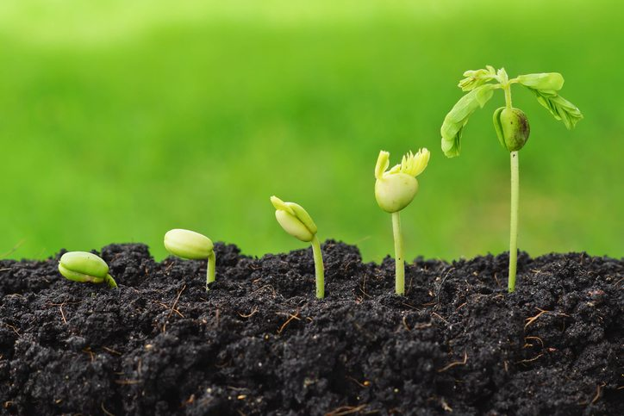
Proposed System Methodology
CROP RECOMMENDATION
The existing system predicts the crop by using the soil parameters while the proposed system obtains environmental factors automatically and would find suitable crops using KNN Classification.
And here the crop is predicted based on the farmers interest in the use of fertilizers.

Slide 10
How we predict the right Crop ?
CROP PREDICTION
Features required for prediction
Temperature
Humidity
Rainfall
Season
Target
Crop Name
These features can be automatically predicted by knowing the farmer’s location.

Slide 11
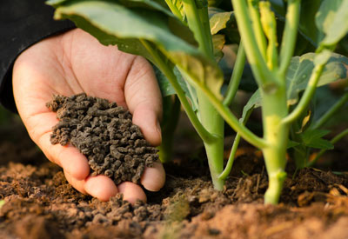
FERTILIZER RECOMMENDATION
In this phase the prediction is done in the following manner,
If the farmer is not interested in using Fertilizers, then the farmer has to provide the NPK values, then this system would recommend a crop based on these NPK values.
Or on the other hand, if the farmer has no problems using Fertilizers, then the crop recommendation is done by knowing the farmer’s location. After that, the NPK values are predicted using the chosen crop and environmental factors. Using these NPK values, crop type and soil type, this system would predict the fertilizer which is required to maximize the production.

Slide 12
PREDICTION METHOD
NPK PREDICTION
Features required for prediction
Temperature
Humidity
Rainfall
Crop
Here environmental factors are automatically determined using weather API.
Target
Nitrogen content
Phosphorus content
Potassium content
FERTILIZER PREDICTION
Features required for prediction
Nitrogen
Phosphorus
Potassium
Soil Type
Crop Type
Temperature
Humidity
Target
Fertilizer Name

Slide 13
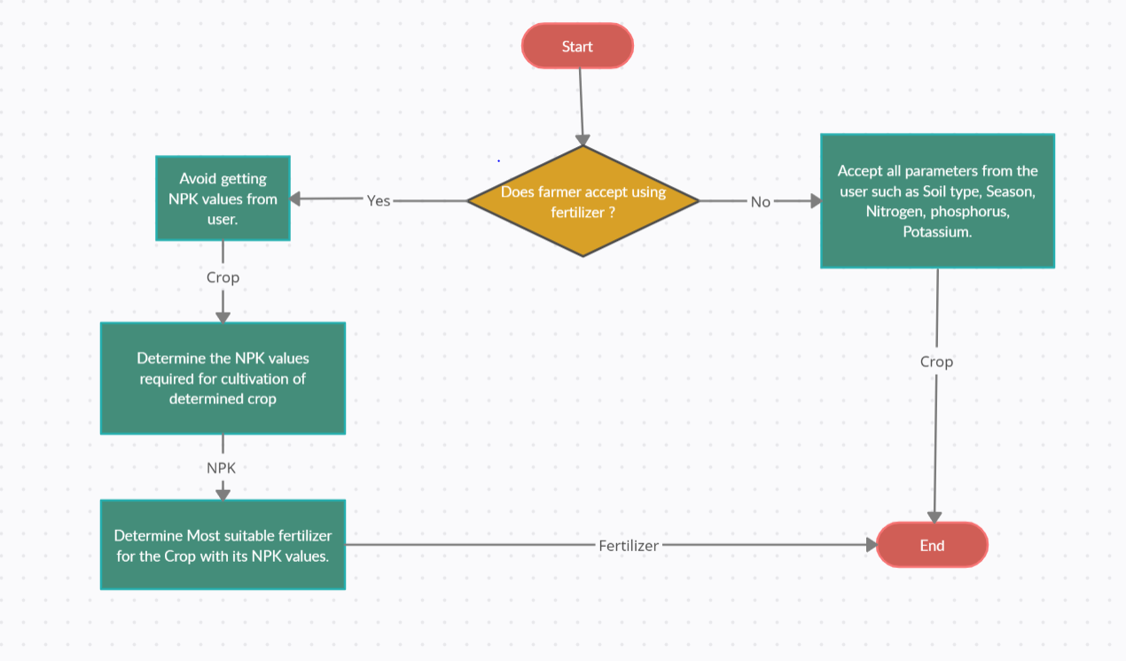
CROP RECOMMENDATION FLOW DIAGRAM

Slide 14
CROP - WEED DETECTION
This project also includes weed detection which is present in crops, which is very much helpful for farmers in boosting their annual production.
It has focused on the creation of an image-processing algorithm to detect the existence of weeds in a specific site of crops.
Finally, a labeling of objects has been made in the image so that weed detection can be done using a threshold based on the area of detection.
In addition, it increases the performance of operational processes in crop management, reducing the time spent searching for weeds throughout a plot of land.

Slide 15
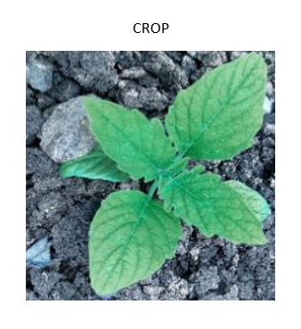
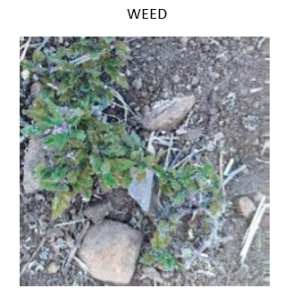
CROP - WEED DETECTION

Slide 16
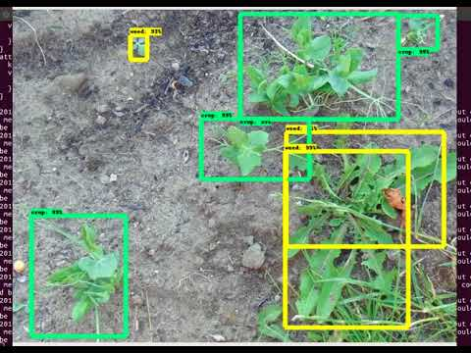
CROP - WEED CLASSIFICATION

Slide 17
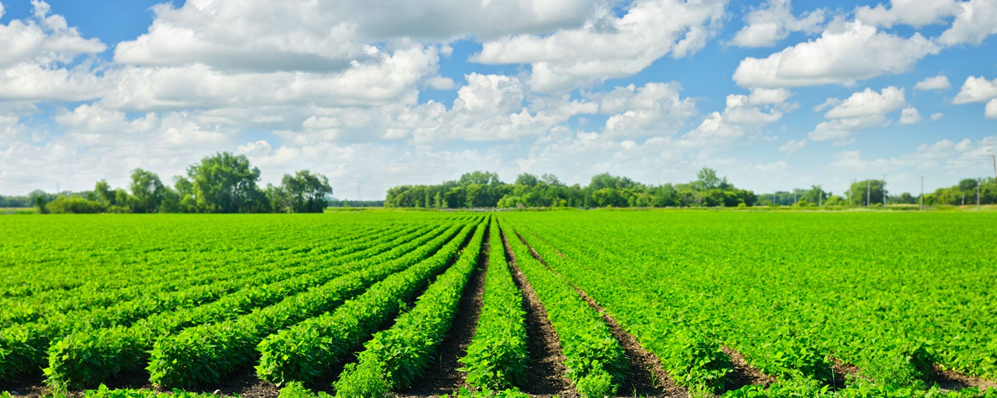
CROP YIELD / PRODUCTION
In this project, we also predict the amount of crop that the farmer can cultivate, this prediction is based on the farmer’s location, seasonal changes, crop type and the amount of area used for cultivation. So based on this the farmer can decide whether to go ahead with the chosen crop or to choose a different crop.

Slide 18
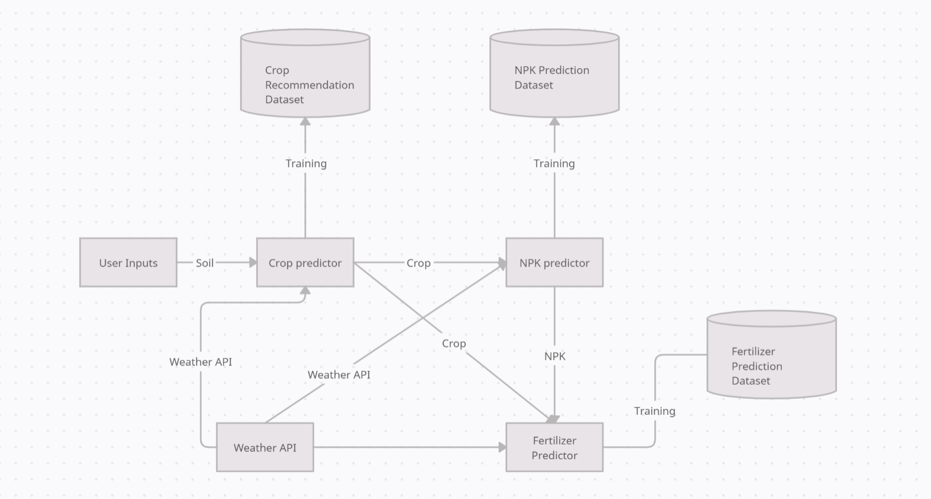
Overview of the project with block diagram / Flow diagram

Slide 19




Hardware and Software Requirement
Software
OpenCV
Scikit Learn
Flask
Tools used - Jupyter NoteBook ( Anaconda ), VScode
Hardware
System - Intel Core i3 processor, 8GB RAM,
1.10 GHz CPU speed.
Camera - 12MP

Slide 20
Work plan
Module 1
Crop prediction training, modeling and predicting, testing.
Determining required NPK concentration of soil for predicted crop.
Determining the most suitable fertilizer on lack of NPK.
Module 2
Weed detection algorithm - training and testing.
Module 3
Crop production algorithm

Slide 21
References
[1] Z. Doshi, S. Nadkarni, R. Agrawal and N. Shah, "Agro Consultant: Intelligent Crop Recommendation System Using Machine Learning Algorithms," 2018 Fourth International Conference on Computing Communication Control and Automation (ICCUBEA), Pune, India, 2018, pp. 1-6, doi: 10.1109/ICCUBEA.2018.8697349.
[2]R, Bharath & Kempegowda, Balakrishna & A, Bency & M, Siddesha & R, Sushmitha. (2019). Crop Recommendation System for Precision Agriculture. International Journal of Computer Sciences and Engineering. 7. 1277-1282. 10.26438/ijcse/v7i5.12771282.
[3] X. Jin, J. Che and Y. Chen, "Weed Identification Using Deep Learning and Image Processing in Vegetable Plantation," in IEEE Access, vol. 9, pp. 10940-10950, 2021, doi: 10.1109/ACCESS.2021.3050296.
[4] Dr. A. K. Mariappan, Ms. C. Madhumitha, Ms. P. Nishitha, Ms. S. Nivedhitha, “Crop Recommendation System through Soil Analysis Using Classification in Machine Learning”, IJAST, vol. 29, no. 3, pp. 12738 - 12747, Mar. 2020.
[5] R. Luciani, G. Laneve and M. JahJah, "Agricultural Monitoring, an Automatic Procedure for Crop Mapping and Yield Estimation: The Great Rift Valley of Kenya Case," in IEEE Journal of Selected Topics in Applied Earth Observations and Remote Sensing, vol. 12, no. 7, pp. 2196-2208, July 2019, doi: 10.1109/JSTARS.2019.2921437.

Slide 22
ABSTRACT SUBMITTED: YES
BASE PAPER SUBMITTED: YES
SDG : GOAL 2 - ZERO HUNGER - END HUNGER, ACHIEVE FOOD SECURITY AND IMPROVED NUTRITION AND PROMOTE SUSTAINABLE AGRICULTURE.
DOMAIN: MACHINE LEARNING
SOCIAL RELEVANT: YES ( AGRICULTURE )
PATENT: NO
PUBLICATION DETAILS:
COMPANY: NO
GOVERNMENT: NO

